Slide 1
Football Ball and player Detection Using YOLO

Slide 2
introduction
Detecting and tracking football and players in real-time helps in making better game decisions and analyzing performance.

Slide 3
Objective
This project is to develop a system that can detect and track football and players in real-time, enabling strategic decision-making, enhancing sports analytics, and automating game performance analysis. This system aims to provide a clearer vision for analysts and effectively convey football-related insights, even to those without prior knowledge of sports analytics.

Slide 4
Implementation Overview
Video Input
Users can upload football match footage using a convenient file uploader.
YOLO Detection
The system detects players and the football in each frame, providing confidence scores for every detection.
Real-Time Display
The processed video is shown with detection boxes overlaid, offering a clear, real-time visualization of the tracked objects.

Slide 5
Object Detection Using YOLO
YOLO --- The latest version of the 'You Only Look Once' family of models for real-time object detection.
Fast and Efficient --- Suitable for real-time applications.
Accurate Detection --- Identifies multiple objects like footballs and players simultaneously.

Slide 6
How YOLO v8 Works in This Project
Video input is processed frame by frame.
YOLO v8 detects the ball and players.
Bounding boxes with labels (Player/Ball) and confidence scores are generated.
The results are displayed in real-time using Streamlit.

Slide 7
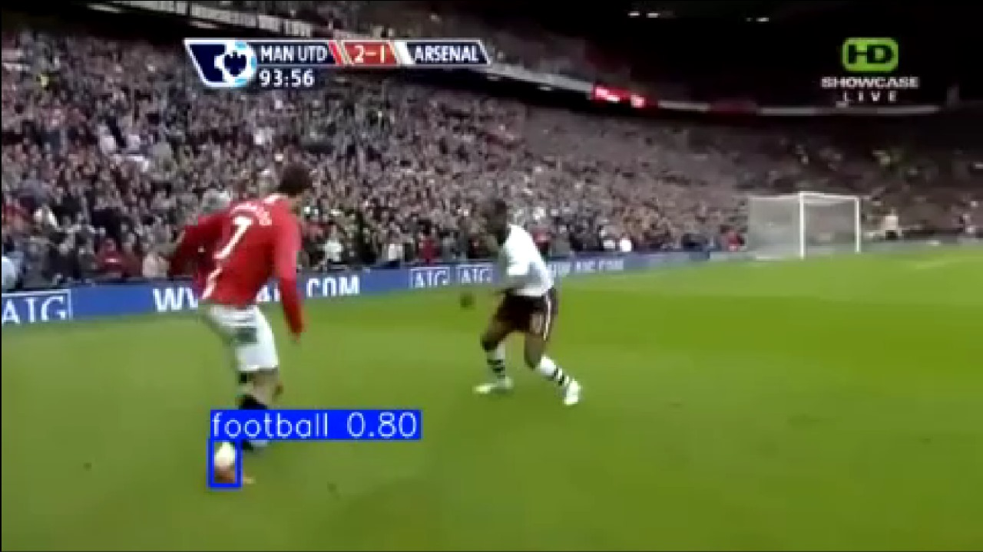
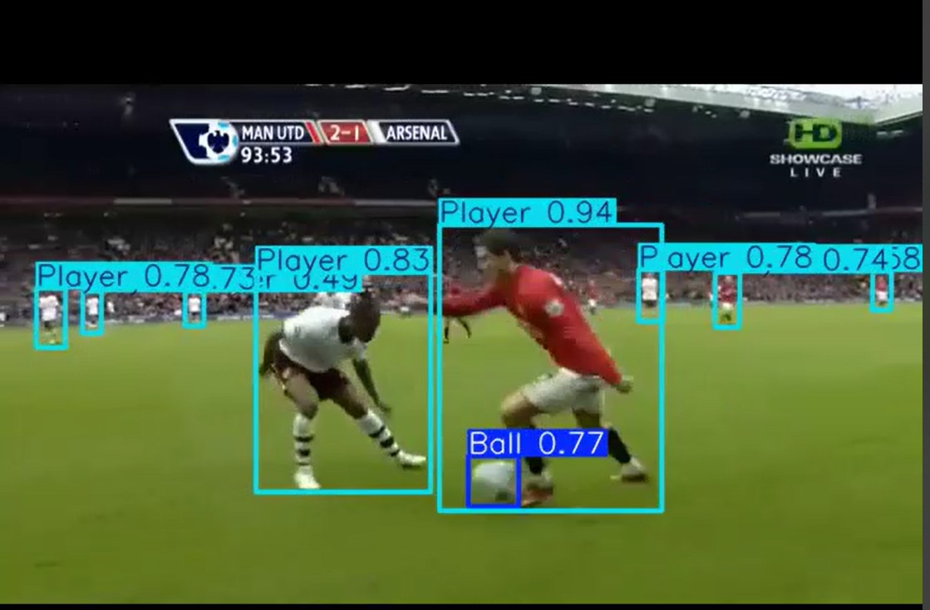
Sample Detection Results
IMAGE/VIDEO FRAMES .
Show screenshots of the bounding boxes around players and the football with confidence scores.

Slide 8

Key Features of the Model
Real-time Processing
Handles fast-paced football matches.
High Accuracy
Detects players and the football accurately, even in crowded or fast-moving situations.
Versatility
Can be adapted for other sports or scenarios.

Slide 9

Applications
Player Tracking >>>
Monitor player movements in real-time.
Game Analysis >>>
Helps in analyzing ball trajectories and team strategies.
Referee Assistance>>>
Can be used in automated refereeing for offside or goal-line decisions.

Slide 10


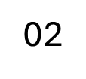
BETTER TRACKING
Accurate tracking of players and the ball using GPS and motion sensors, providing real-time updates on movements and interactions.
FUTURE GOALS
PERFORMANCE ANALYSIS
AI REFEREE ASSISTANCE
Detailed reports on player and team performance after the game, with data used to improve training and strategies.
AI helps make quick decisions on fouls and offsides, with faster and more reliable VAR integration.

Slide 11
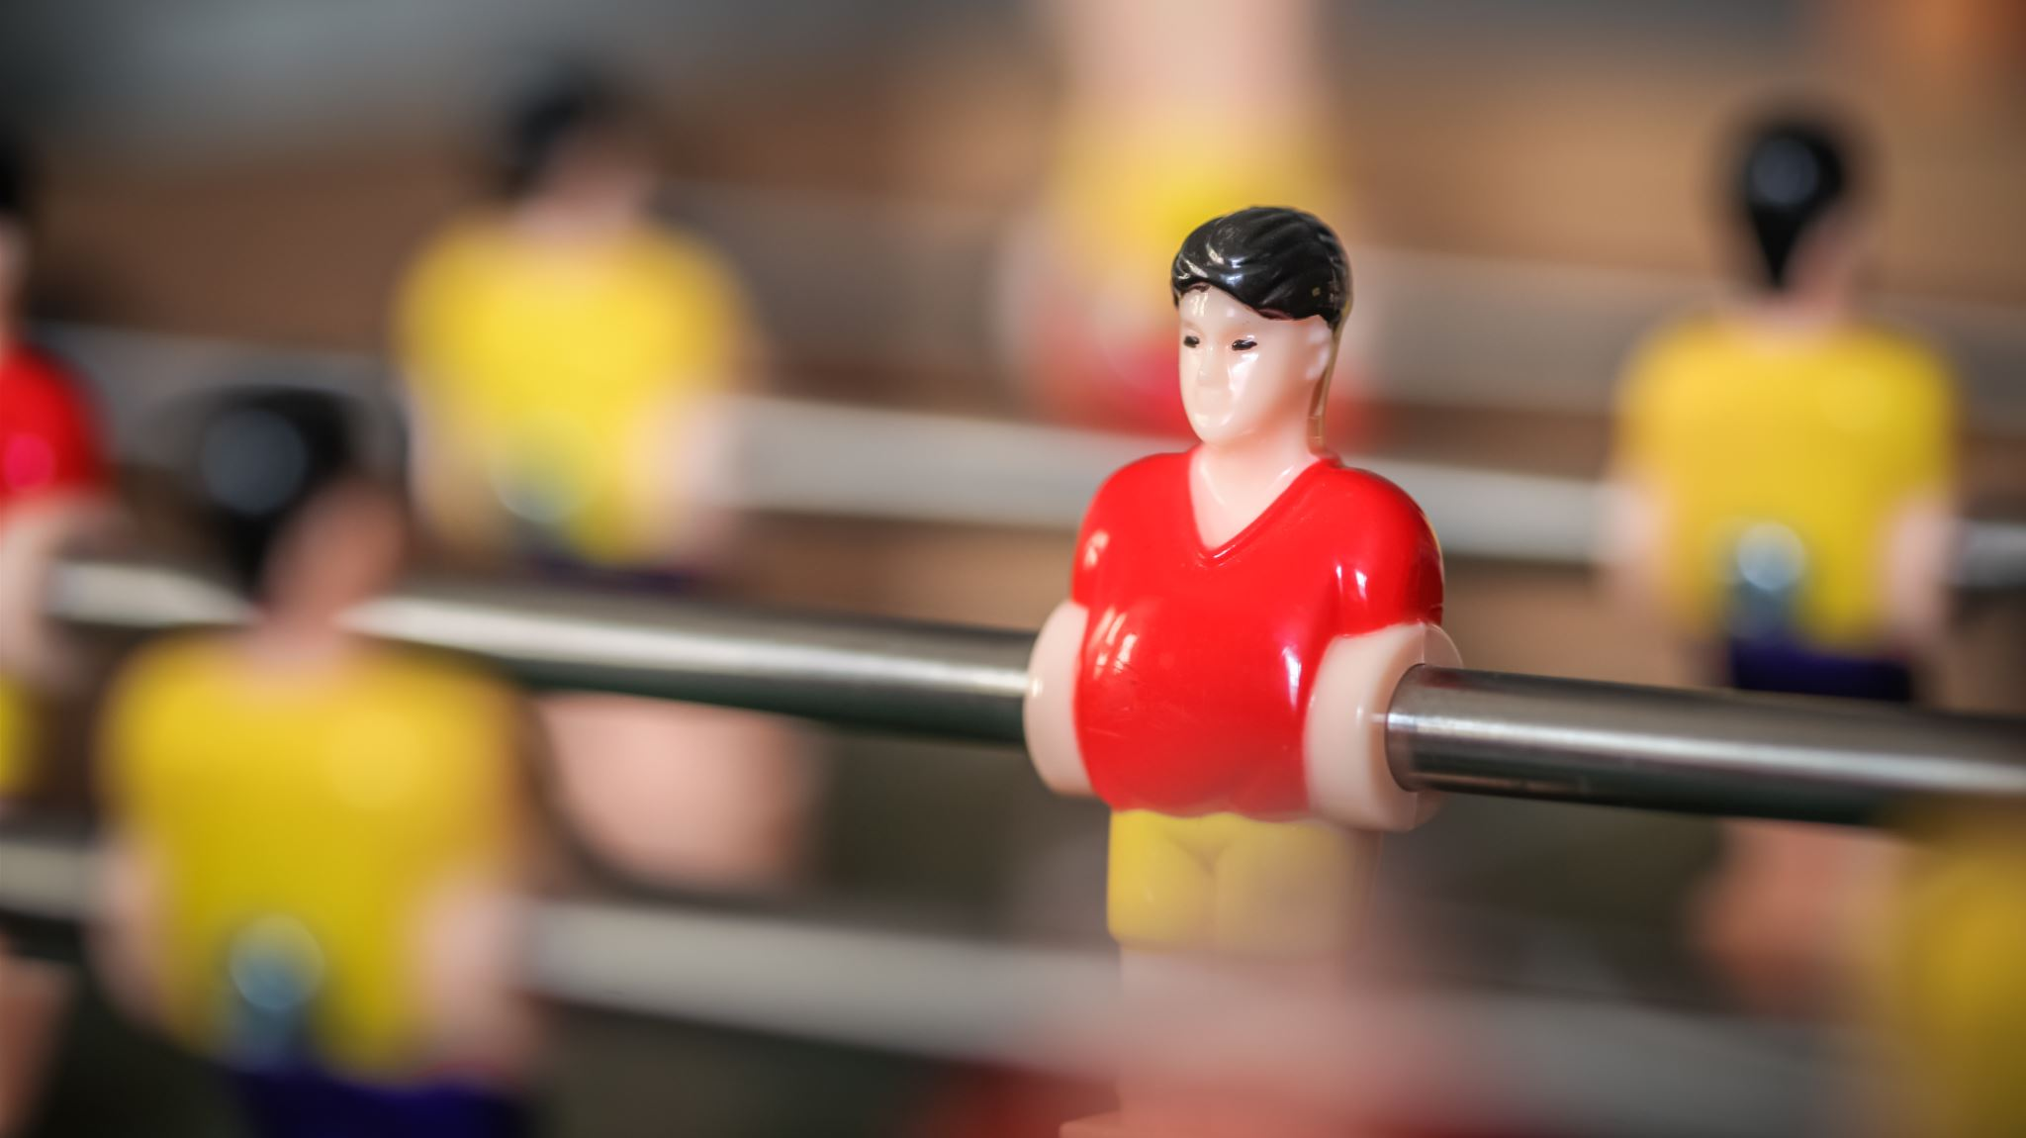
Conclusion
Summary : YOLO is an effective tool for real-time football detection.
Future Enhancements : Can integrate additional features like player performance analysis, game statistics, and AI-assisted refereeing.

